Slide 1




DeCovarT: A network-centric approach for enhanced deconvolution of closely related cell types
Bastien CHASSAGNOL
Mickaël GUEDJ, Etienne BECHT (Servier),
Gregory NUEL (LPSM), Pierre-Henri WUILLEMIN (LIP6)
Computer sciences
Statistics and
Probability
Pharmaceutical company

Slide 2
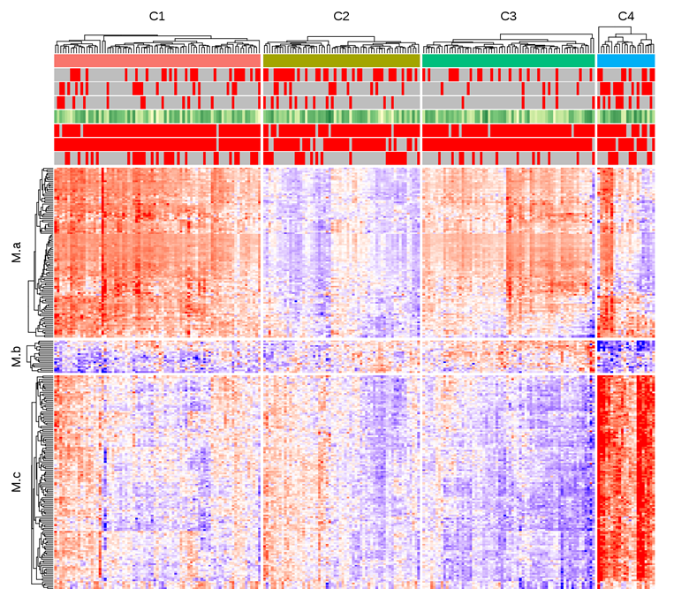
Limitations of bulk transcriptome approaches
Four clusters of patients
Log2 (IFNα)
Three modules of genes
C1 C2 C3 C4 Healthy
Heatmap showing the distribution of gene transcripts across the 4 clusters.
https://pubmed.ncbi.nlm.nih.gov/34112769/
Soret et al, 2021, Nature Communications
2
Introduction
Mixture models
Deconvolution
Perspectives

Slide 3

Limitations of bulk transcriptome approaches
Healthy state
Disease state
Shoemaker et al. 2012
3
Introduction
Mixture models
Deconvolution
Perspectives

Slide 4
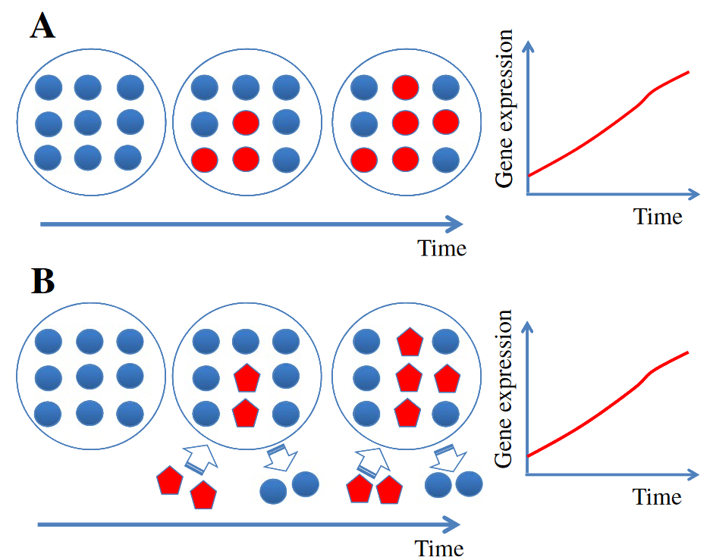
Limitations of bulk transcriptome approaches
Healthy state
Disease state
⇨
resting cell population 1
activated cell population 1
Scenario A: increase of the gene expression is generated by an activation of cell population 1
Shoemaker et al. 2012
4
Introduction
Mixture models
Deconvolution
Perspectives

Slide 5
Limitations of bulk transcriptome approaches
Healthy state
Disease state
Shoemaker et al, 2012, BMC genomics
https://doi.org/10.1186/1471-2164-13-460
resting cell population 1
activated cell population 1
activated cell population 2
⇨
⇨
Scenario A: increase of the gene expression is generated by an activation of cell population 1
Scenario B: the gene expression increases due to the arrival of a new cell population 2
5
Introduction
Mixture models
Deconvolution
Perspectives

Slide 6
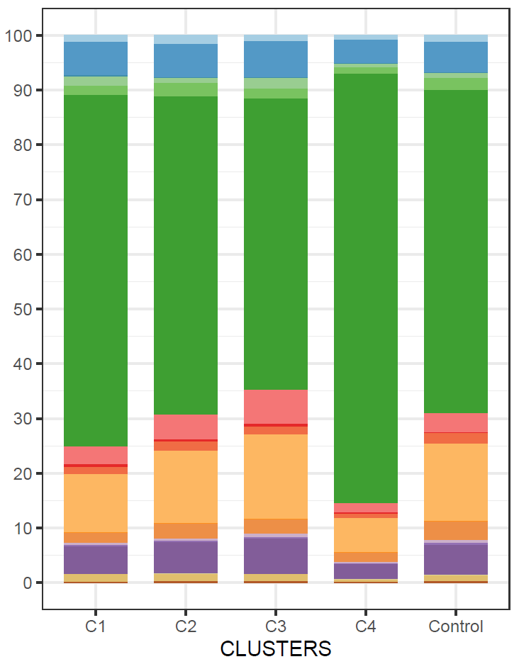
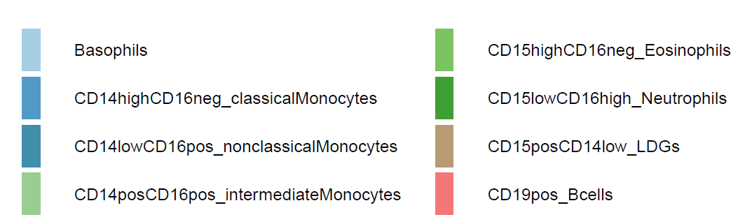
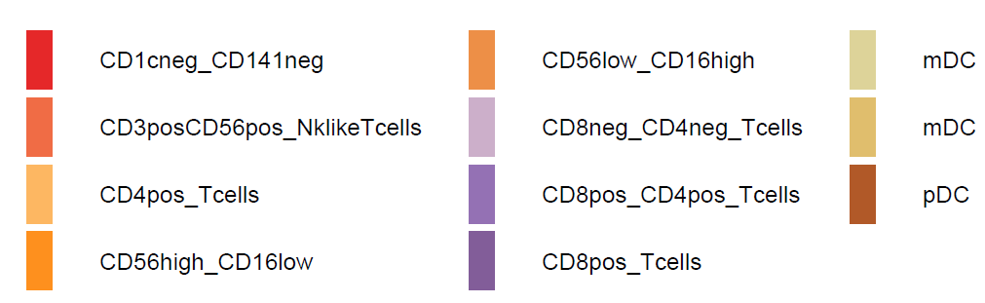
Limitations of bulk transcriptome approaches
Healthy state
Disease state
Shoemaker et al, 2012, BMC genomics
https://doi.org/10.1186/1471-2164-13-460
activated cell population 2
Scenario B: the gene expression increases due to the arrival of a new cell population 2
FACS cytometry ratios
6
Introduction
Mixture models
Deconvolution
Perspectives

Slide 7
Outline of cellular deconvolution
1
01
Why Deconvolution?
2
02
Integrating Regulatory Pathways to Refine Cell-Type Characterization
3
DeCovarT: a network-centric approach to deconvolution
03
4
Towards the Third Generation
Of Deconvolution Algorithms
04
7
Introduction
Mixture models
Deconvolution
Perspectives

Slide 8
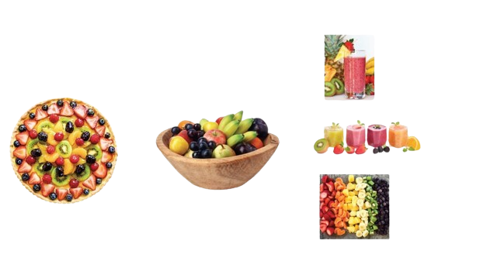
Technical approaches to overcome bulk limitations
Complex tissue
FACS + bulk omics
Single Cell
https://tumorgenetics.blog/2022/01/10/the-development-of-spatial-transcriptomics/
Spatial transcriptomics

Slide 9
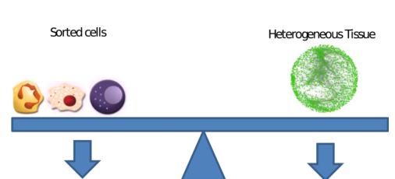
Key Strategies to Overcome the Averaging Limitation in Bulk Measurements
Complex tissue
Dilemma between physical identification of cell populations (FACS, IHC, scRNA-Seq) or whole transcriptomic(RNASeq, microarray).
FACS + bulk omics
Single Cell
https://tumorgenetics.blog/2022/01/10/the-development-of-spatial-transcriptomics/
Spatial transcriptomics

Slide 10
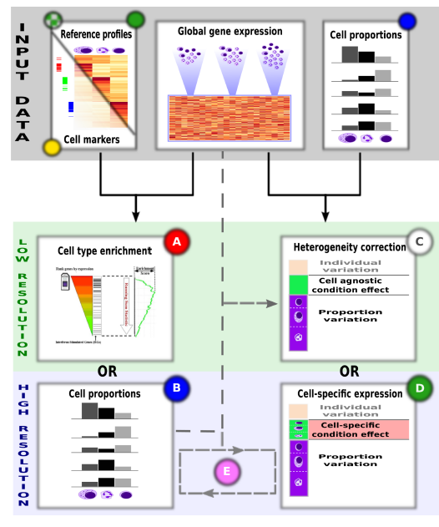
Computational approaches to overcome bulk limitations
Estimate the ratios p for all individuals with the purified cell signature X and bulk mixture y.
Try to infer cell specific expression profiles X based on p and y.
Try to infer alternatively both p and X (unsupervised, reference-free methods). Undetermined problem without prior.
Partial deconvolution
Complete deconvolution
Main classes of deconvolution algorithms
Shen-Orr et al, 2013

Slide 11
Computational approaches to overcome bulk limitations
Estimate the ratios p for all individuals with the purified cell signature X and bulk mixture y.
Try to infer cell specific expression profiles X based on p and y.
Try to infer alternatively both p and X (unsupervised, reference-free methods). Undetermined problem without prior.
Partial deconvolution
Complete deconvolution
Main classes of deconvolution algorithms
Shen-Orr et al, 2013

Slide 12
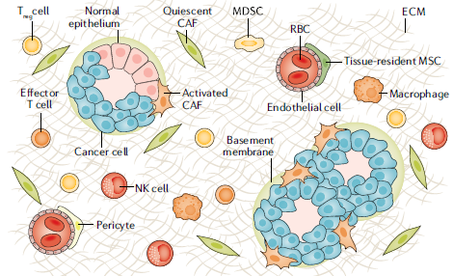
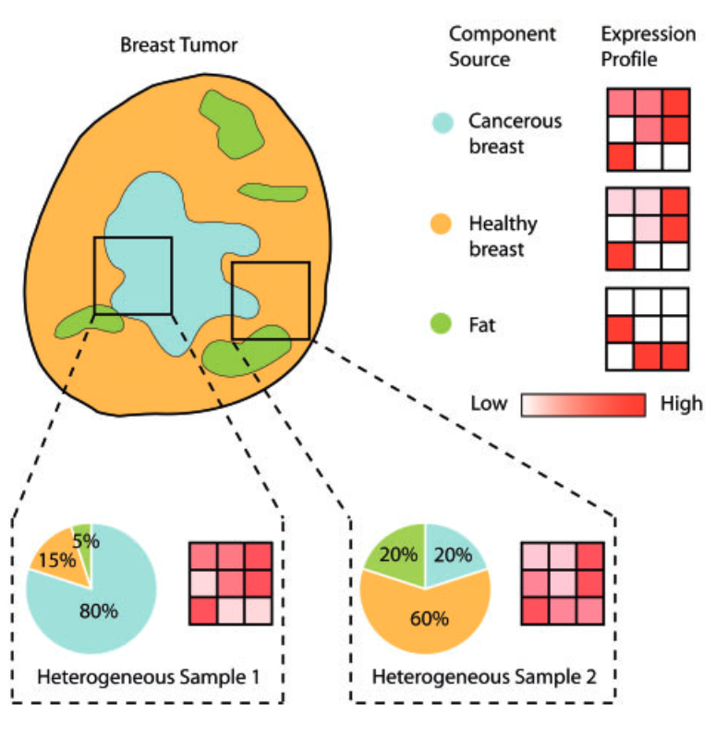
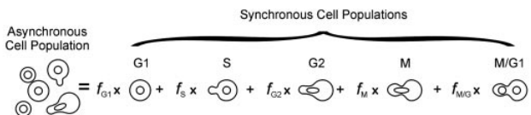
Deconvolution level resolution
Computational approaches to overcome bulk limitations
Mixture of cell populations
e.g. % of immune cells
Finotello and Trajanoski, 2018
Mixture of cell phases
e.g. % of cells in each stage of the cell cycle
Mixture of tissues
e.g. % of tumour cells
Lu et al, 2003
Quon and Morris, 2009
Flexible granularity of deconvolution algorithms

Slide 13
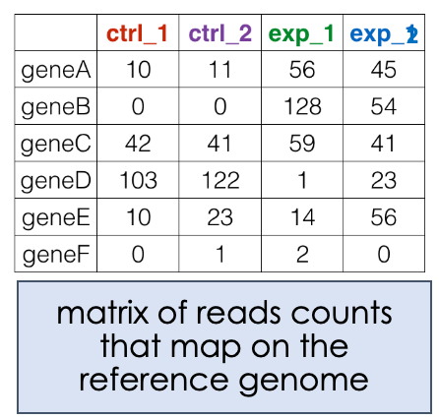
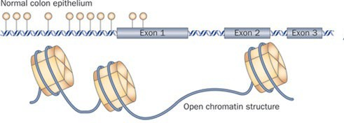
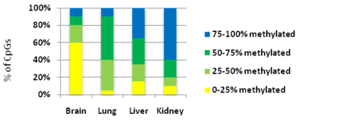








Which biological inputs?
1. Bulk transcriptomic: quantifying mRNA molecules in a soup
2. DNA methylation: complementary proxy to evaluate the regulation of gene expression
Fraction of methylated sites
Manel Esteller, 2002

Slide 14
Which biological inputs?
1. Bulk transcriptomic: quantifying mRNA molecules in a soup
2. DNA methylation: complementary proxy to evaluate the regulation of gene expression
Fraction of methylated sites
Manel Esteller, 2002

Slide 15
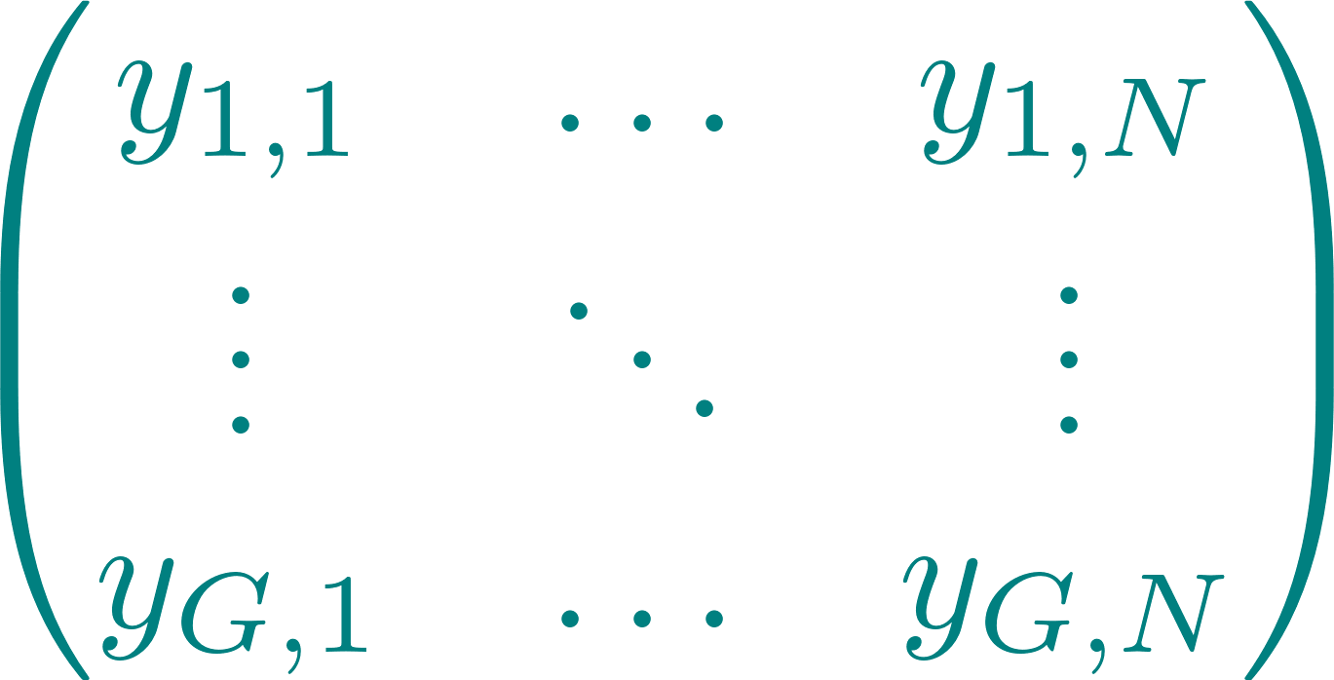
Deconvolution framework
Bulk profile
CD3
MHC-II
CD19
15
Introduction
Mixture models
Deconvolution
Perspectives

Slide 16
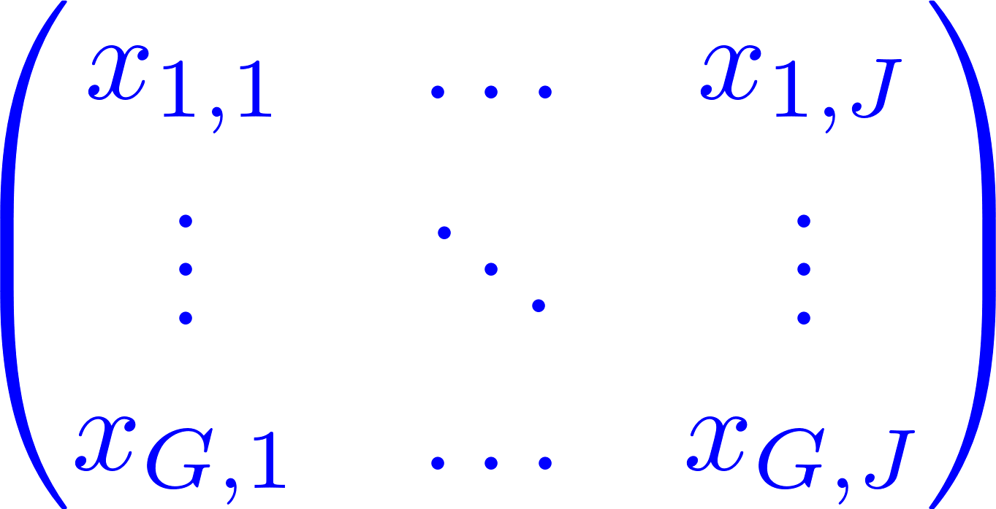
Bulk profile
Deconvolution framework
Purified cellular profiles
CD3
CD19
CD3
MHC-II
CD19
MHC-II
CD3
T cell pathway
CD19
MHC-II
CD3
B cell pathway
CD19
MHC-II
Macrophage pathway
16
Introduction
Mixture models
Deconvolution
Perspectives

Slide 17
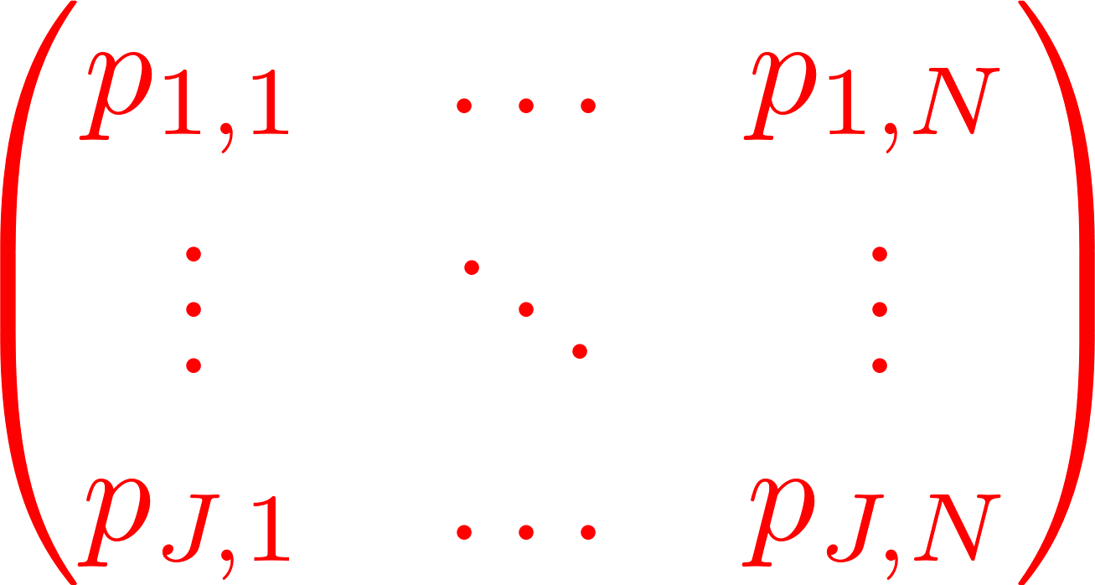

Bulk profile
Deconvolution framework
Purified cellular profiles
CD3
CD19
CD3
MHC-II
CD19
MHC-II
CD3
T cell pathway
CD19
MHC-II
Cell type proportions
CD3
B cell pathway
CD19
T cells
B cells
Macrophages
MHC-II
Macrophage pathway
Deconvolution algorithm
17
Introduction
Mixture models
Deconvolution
Perspectives

Slide 18
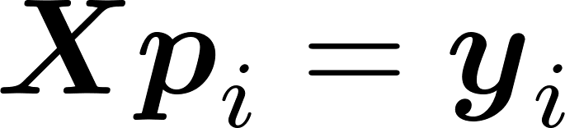
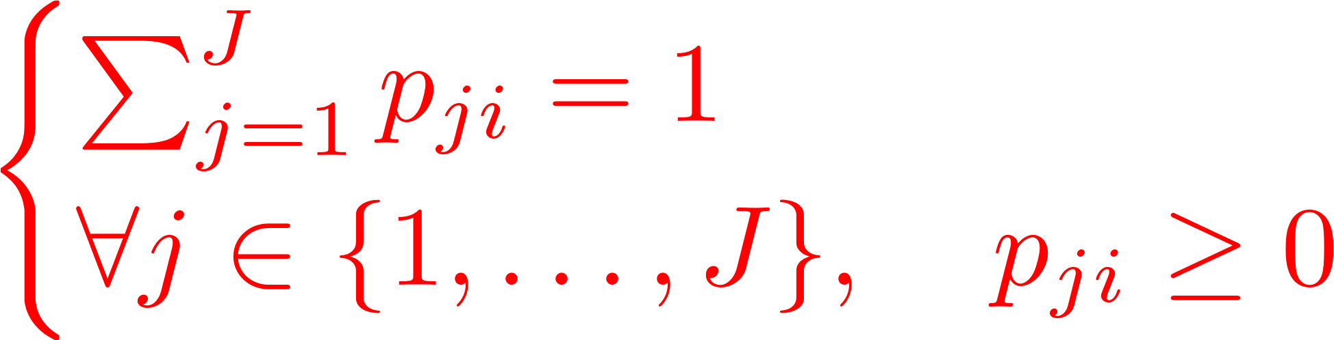
Bulk profile
Deconvolution framework
Purified cellular profiles
CD3
CD19
CD3
MHC-II
CD19
MHC-II
CD3
T cell pathway
CD19
MHC-II
Cell type proportions
CD3
B cell pathway
CD19
T cells
B cells
Macrophages
MHC-II
Macrophage pathway
Deconvolution algorithm
18
Introduction
Mixture models
Deconvolution
Perspectives

Slide 19
Outline of cellular deconvolution
1
01
Why Deconvolution?
2
02
Integrating Regulatory Pathways to Refine Cell-Type Characterization
3
DeCovarT: a network-centric approach to deconvolution
03
4
Towards the Third Generation
Of Deconvolution Algorithms
04
19
Introduction
Mixture models
Deconvolution
Perspectives

Slide 20
Deconvolution framework
Bulk profile
Purified cellular profiles
CD3
CD19
MHC-II
CD3
MHC-II
CD19
CD3
T cell pathway
CD19
MHC-II
Cell type proportions
CD3
B cell pathway
CD19
T cells
B cells
Macrophages
MHC-II
Macrophage pathway
Deconvolution algorithm
20
Introduction
Mixture models
Deconvolution
Perspectives

Slide 21
Deconvolution framework
Bulk profile
Purified cellular profiles
CD3
CD19
MHC-II
CD3
MHC-II
CD19
CD3
T cell pathway
CD19
MHC-II
Cell type proportions
CD3
B cell pathway
CD19
T cells
B cells
Macrophages
MHC-II
Macrophage pathway
Deconvolution algorithm
21
Introduction
Mixture models
Deconvolution
Perspectives

Slide 22
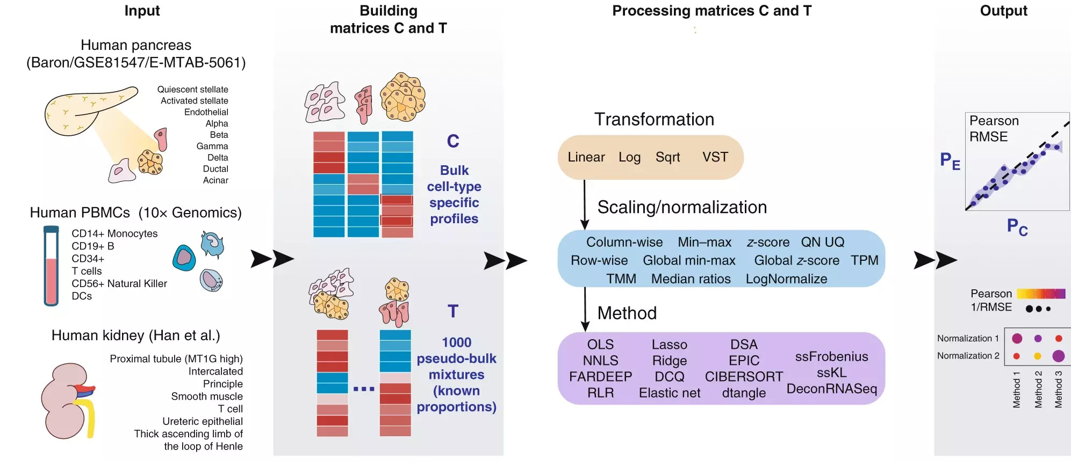
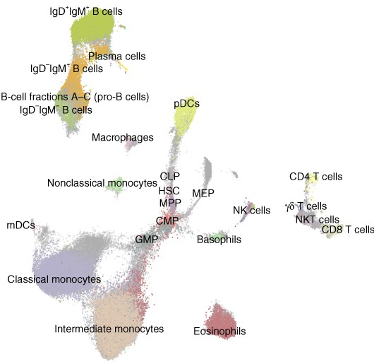
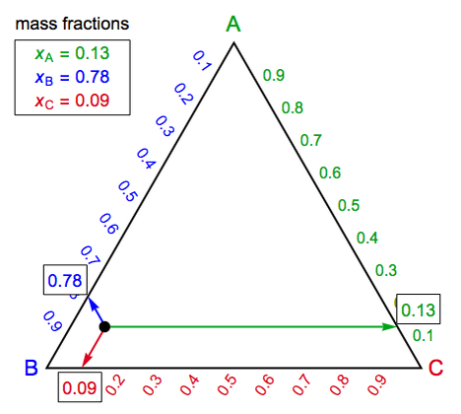
Overview of deconvolution pipeline
Step 3: DeCovarT
Step 1: collection and curation of datasets
Step 2: learn cell-type specific features
Step 4: biological exploitation
https://doi.org/10.1186/s13059-021-02290-6
Haijing, 2019, Genome Biology
22
Introduction
Mixture models
Deconvolution
Perspectives

Slide 23

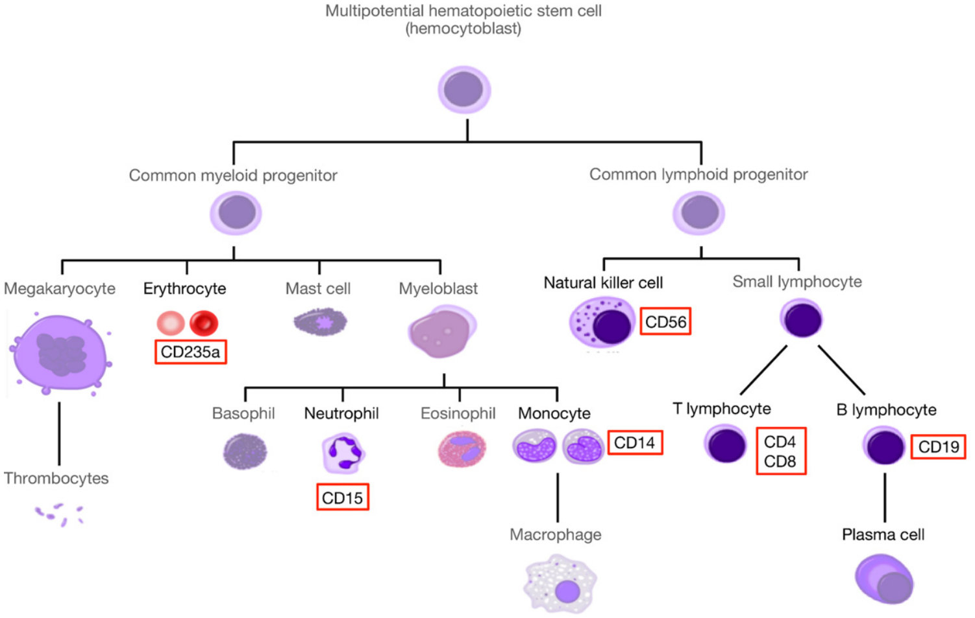
Deconvolution workflow
Step 1: data collection
Innovation 1: use ontologies
pDCs
Tregs
cDC
Haematopoiesis lineage tree
https://bmcbioinformatics.biomedcentral.com/articles/10.1186/s12859-019-2994-z
2019, Torang, BMC Bioinformatics
Homogenise cell labelling

Slide 24
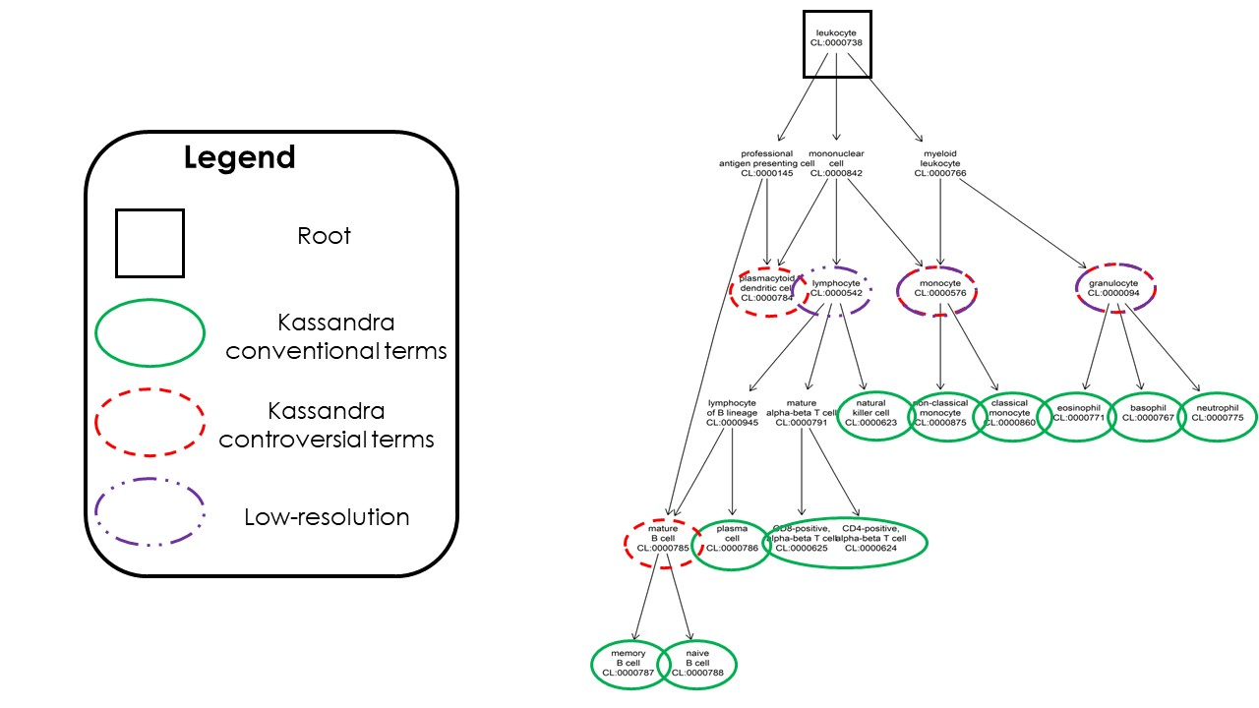
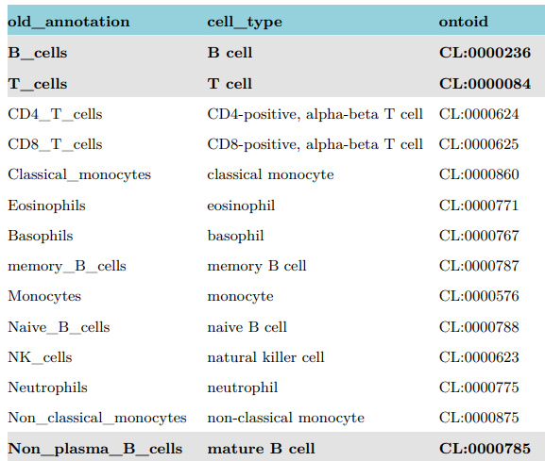
Step 1: data collection
Deconvolution workflow
Step 1: data collection
Innovation 1: use ontologies
Automated cell ontology using ontoProc (Channing, 2022) package
Mapping table linking Kassandra with haematologists approved terms
Homogenise cell labelling

Slide 25
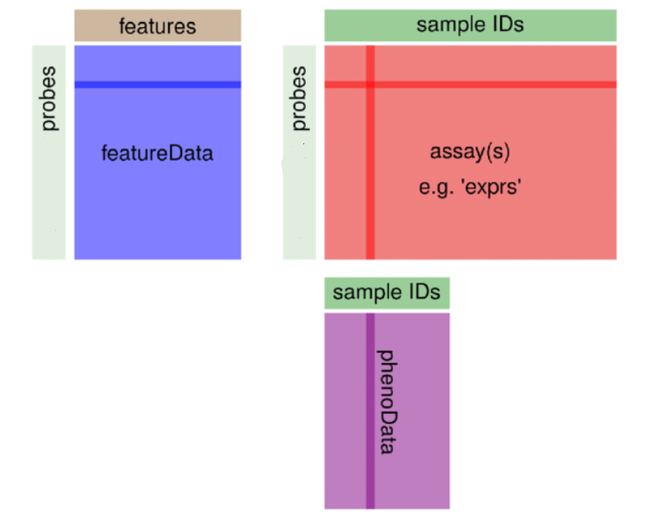
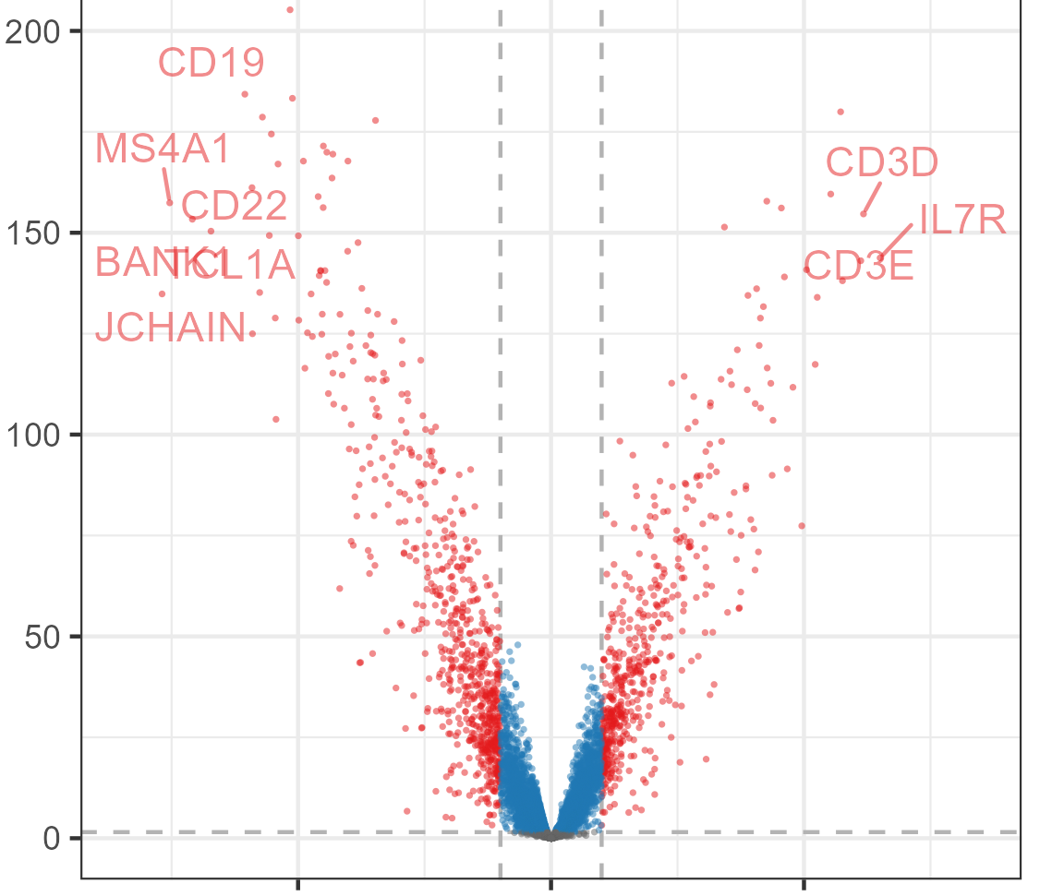
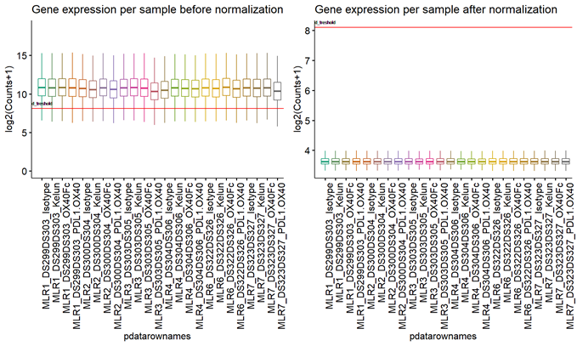
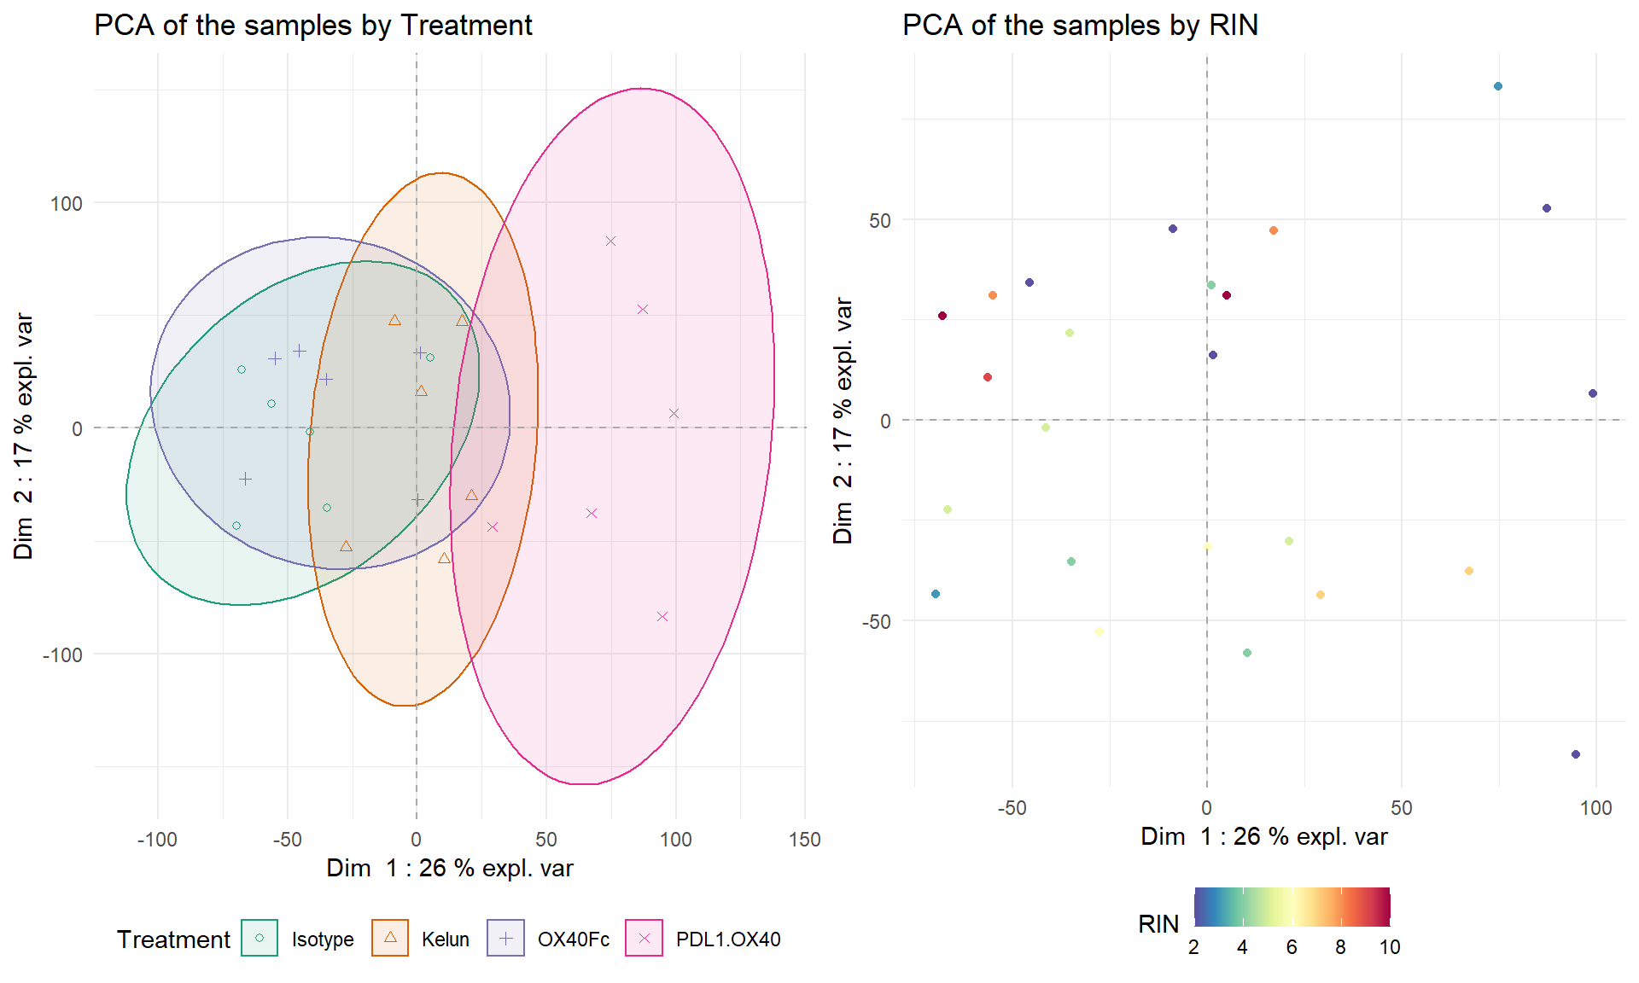
Standard transcriptomic pipeline
Bulk RnaSeq workflow
Step 1: data collection
1 - Data management
2 - Data quantification
Transformation
bbcWrangling
bbcPreprocessing
Filtering noisy genes
Filtering low
quality samples
Normalisation
5 – Differential expression analysis
4 – Exploratory analyses
bbcSupervised
3 – Quality control
bbcUnsupervised
bbcViz

Slide 26
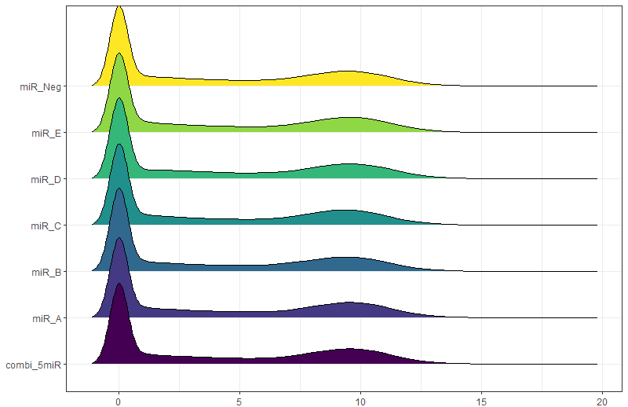
Deconvolution workflow
Step 1: data collection
Innovation 2: use mixture models
Second component =
truly expressed genes
First component =
Noise background
Density distribution of gene counts,
after TPM and log2 normalization
Filter background noise

Slide 27
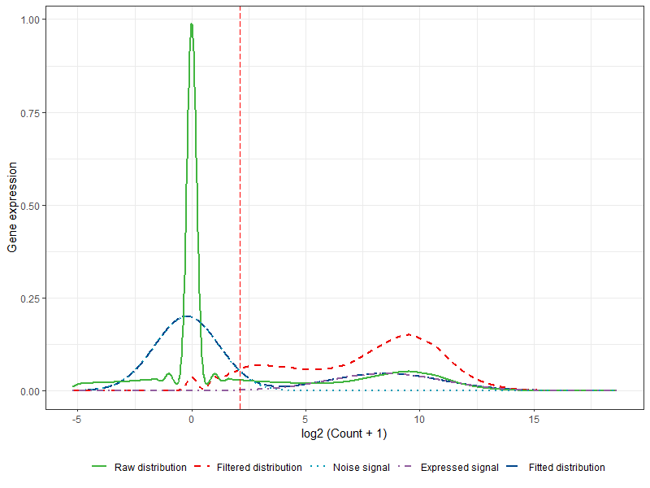
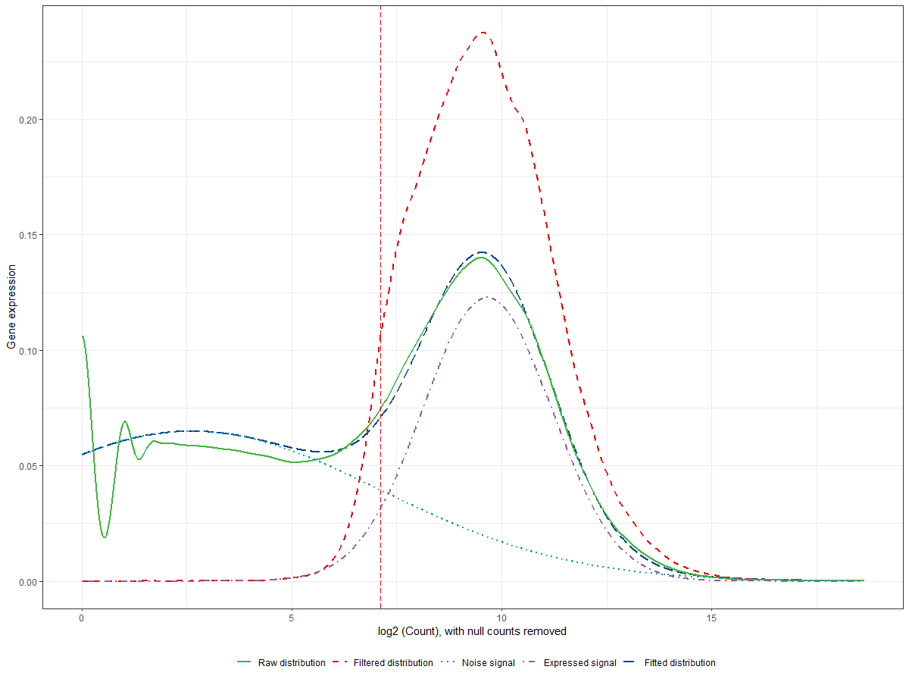
Deconvolution workflow
Step 1: data collection
Innovation 2: use mixture models
Which distribution?
Which method to retrieve the parameters?
Define threshold?
Generalization to other omic types? Robustness to normalization option?
Fitted distributions before and after filtering with artificially symmetrized Gaussian mixtures.
Fitted distributions before and after filtering with zero-inflated Gaussian mixtures.

Slide 28
Overview of deconvolution pipeline
Step 3: DeCovarT
Step 1: collection and curation of datasets
Step 2: learn cell-type specific features
Step 4: biological exploitation
https://doi.org/10.1186/s13059-021-02290-6
Haijing, 2019, Genome Biology
28
Introduction
Mixture models
Deconvolution
Perspectives

Slide 29
i) Network Inference
Deconvolution workflow
Step 2: cellular fingerprints
Bottom-up
(from knowledge)
Literature based
From local to global
Top-down
(data-driven)
Inference from data
Algorithms
Curated databases
Previous knowledge
Reverse engineering
2 strategies to build biological networks

Slide 30
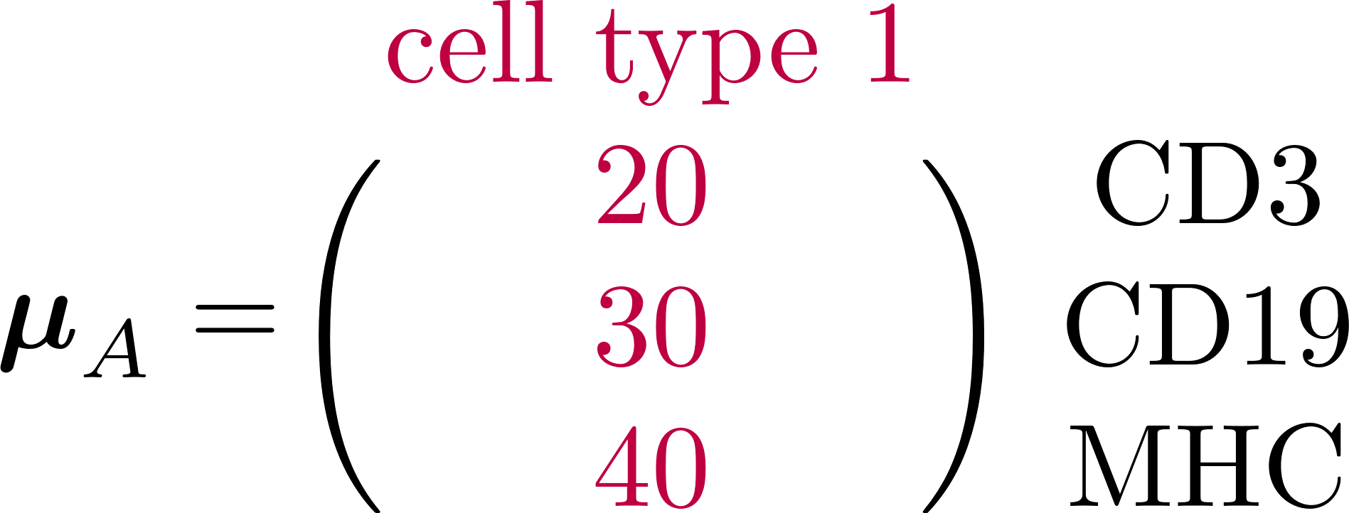
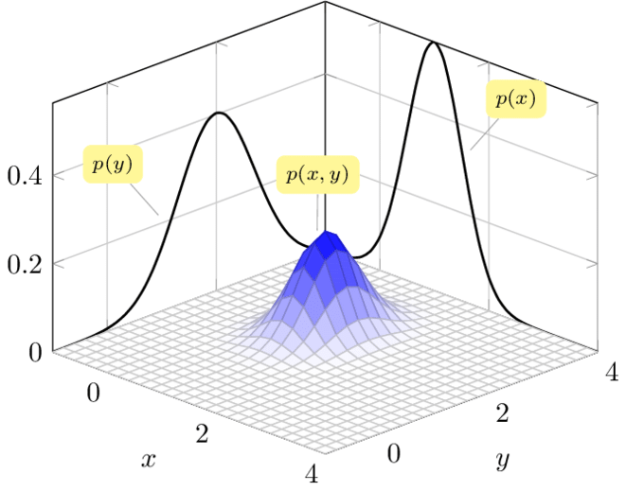
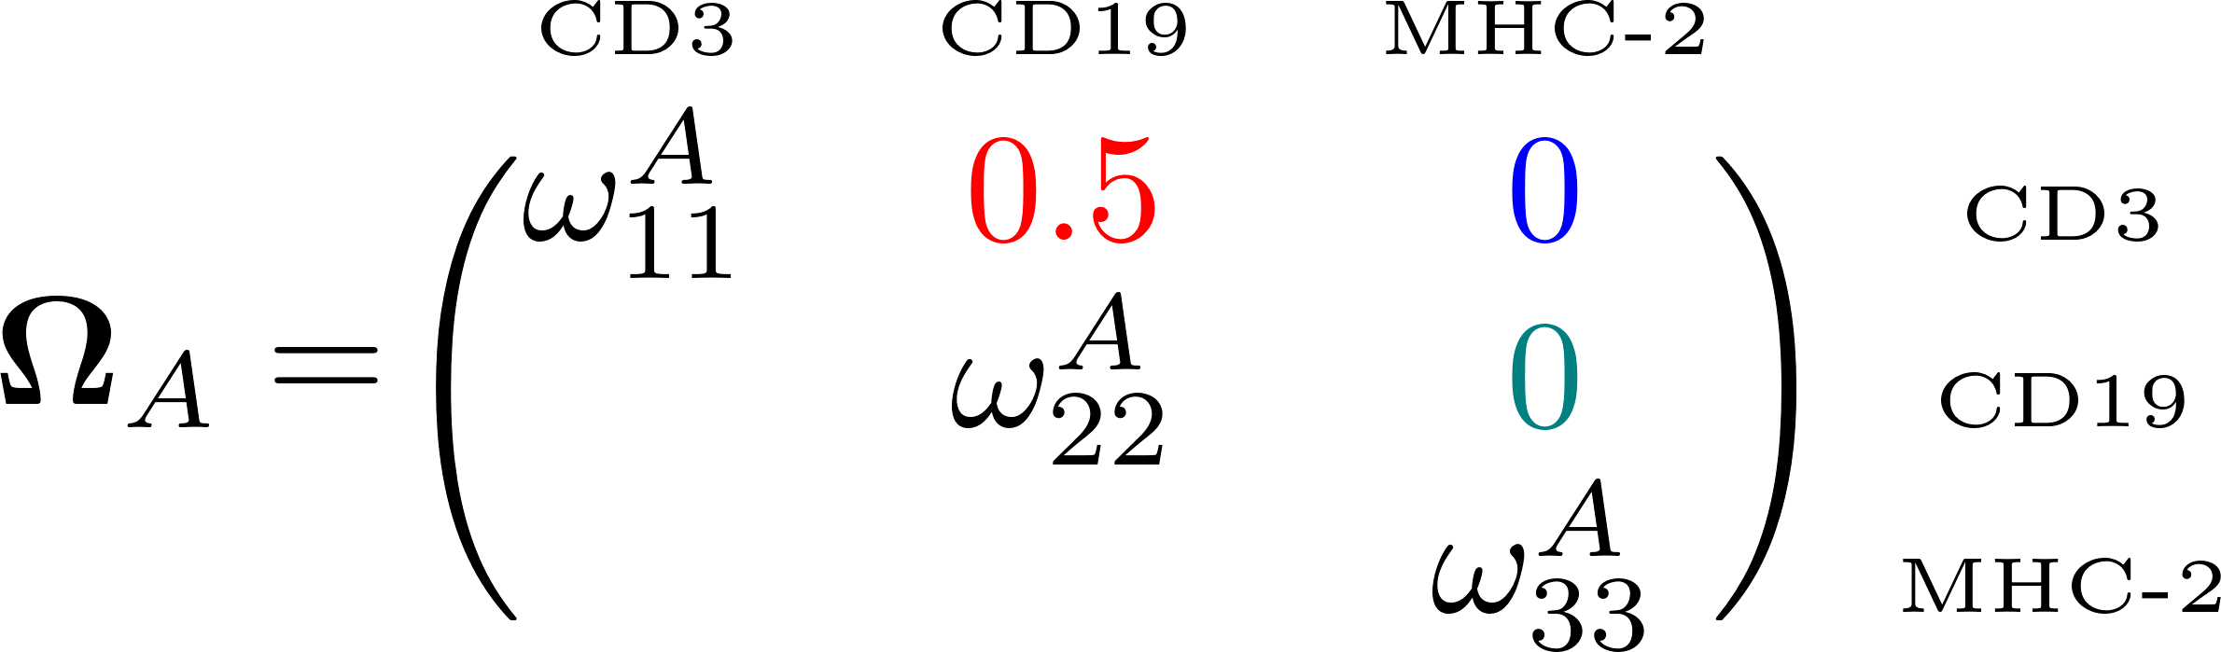



i) Network Inference
Step 2: Infer signature matrix
Multivariate GMM
CD19
CD3
MHC-II
Markov network in cell type A
Precision matrix = inverse of the covariance matrix
Nodes = genes
Edges = direct interaction between two transcripts
Multivariate GMMs are uniquely parametrized
by the mean and covariance parameters.

Slide 31
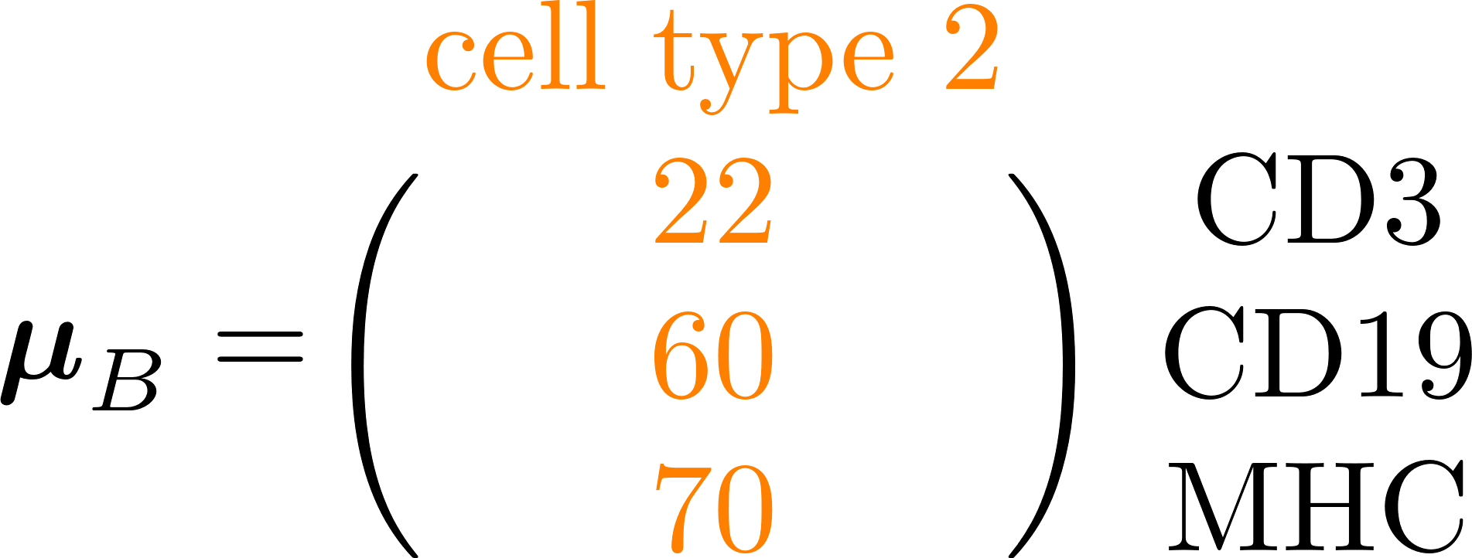
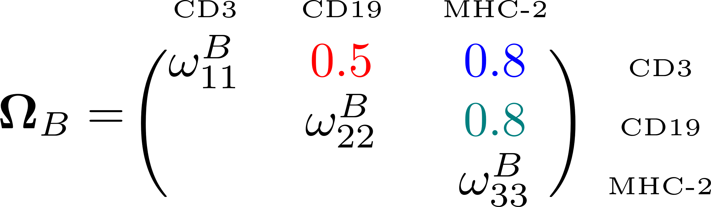
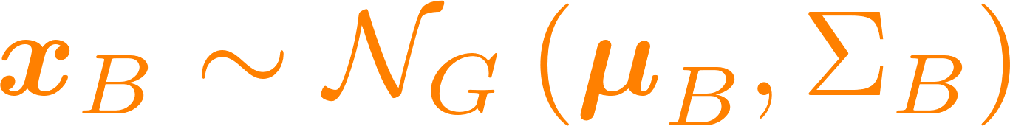
“Curse of dimensionality”!!
Step 2: Learn transcriptomic network
CD19
CD19
CD3
CD3
MHC-II
MHC-II
Sparse network in cell type A
Sparse network in cell type B
31
Introduction
Mixture models
Deconvolution
Perspectives

Slide 32

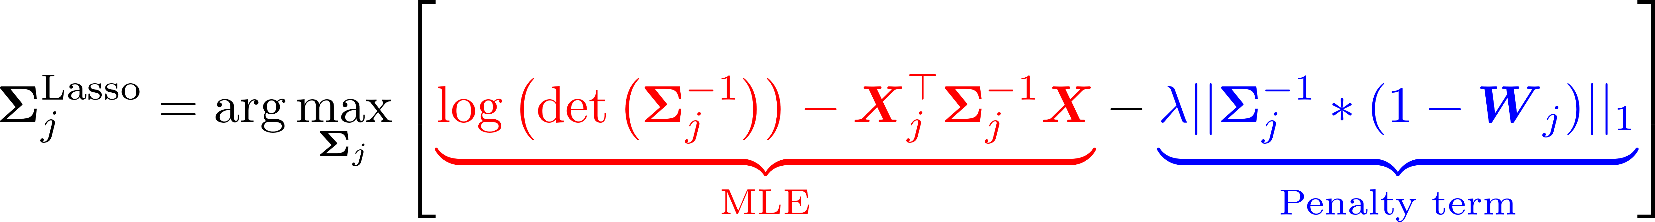
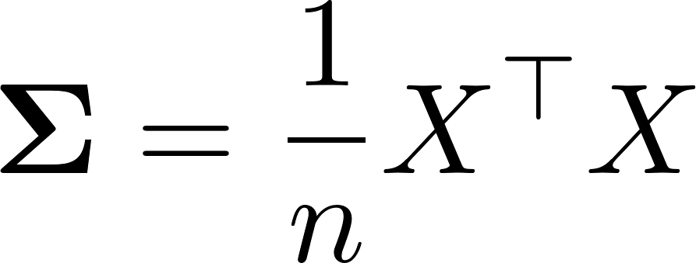
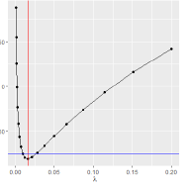
Idea 1: add sparsity
i) Network Inference
Step 2: Infer signature matrix
Penalised Lasso
MLE term
Lasso
Returns the formula of the empirical covariance matrix.
L1-regularisation term
Optional weights W.
Estimated with the gLasso [Friedman et al, 2008]
First method evaluating globally the support.
Use regularisation paths to select the threshold

Slide 33
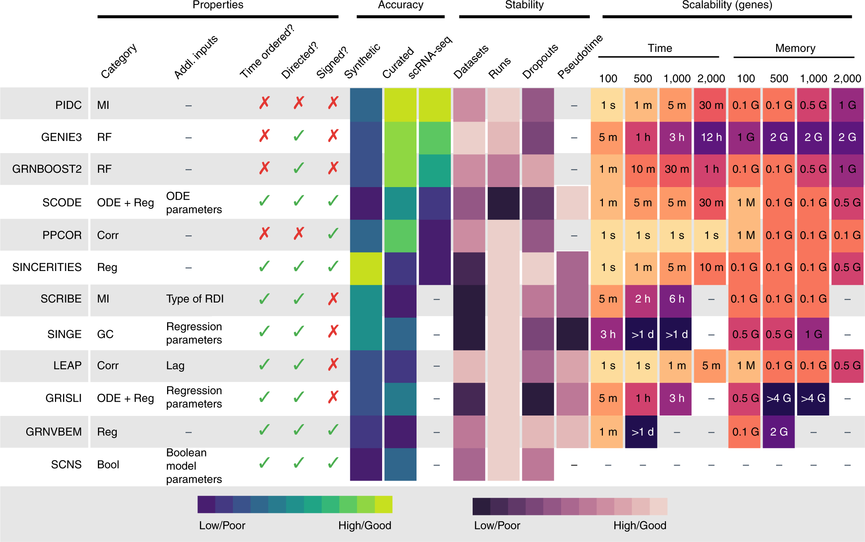
“Curse of dimensionality”: Idea 2: pair single cell RNASeq.
Network Inferences
Step 2: Infer signature matrix
Comprehensive benchmark BEELINE.
Best performing algos don’t need pseudo time information (GENIE3, GRNBoost2 and PIDC):
GENIE3 exhibit better stability
GRNBoost2 is less sensitive to dropouts.
Unfortunately, poor mapping between bulk and single cell-resolved GRNs
https://www.nature.com/articles/s41592-019-0690-6#Sec32
Pratapa et al, 2020, Nature Methods

Slide 34
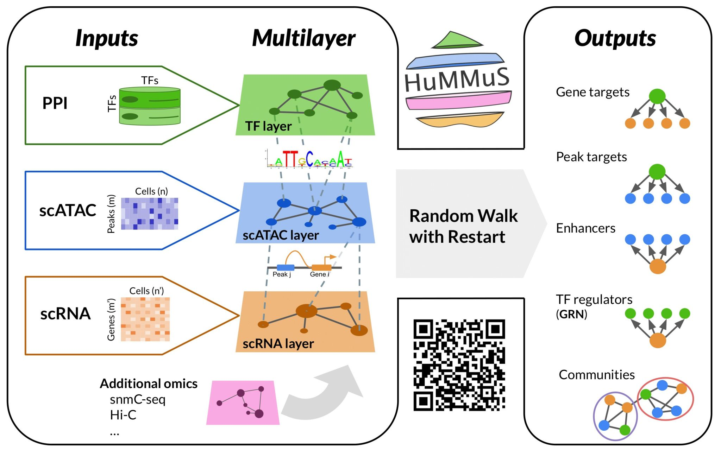
“Curse of dimensionality”: Idea 3: pair scRNASeq and multi-omics integration
Network Inferences
Step 2: Infer signature matrix
HuMMuS: infer regulatory mechanisms from single-cell multi-omics data
Captures cross-over interactions between and within biological layers (HMLNs): TF, scATAC and scRNA.
Network exploration using Random Walk with Restarts (RRWR).
HuMMuS improves TF targets and regulatory regions prediction, while exhibiting enhanced robustness to impaired datasets.
https://www.biorxiv.org/content/10.1101/2023.06.09.543828v1
Cantini et al, 2023, bioRarxiv

Slide 35
i) Network Inference
Deconvolution workflow
Step 2: cellular fingerprints
Bottom-up
(from knowledge)
Literature based
From local to global
Top-down
(data-driven)
Inference from data
Algorithms
Curated databases
Previous knowledge
Reverse engineering
2 strategies to build biological networks

Slide 36
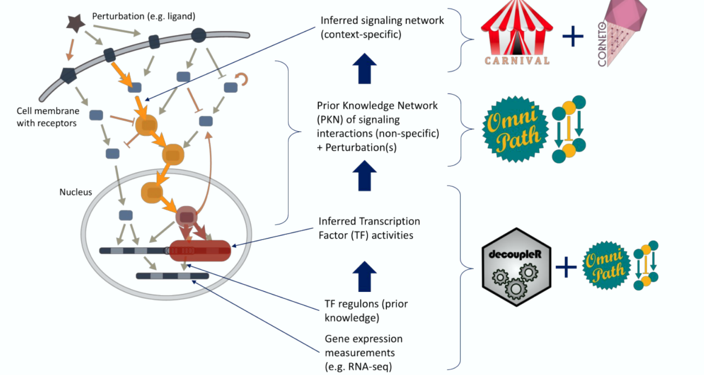
“Curse of dimensionality”: Idea 3: incorporate prior knowledge
Network inference
Step 2: Infer signature matrix
OmniPath, a compendium of curated pathway databases
DecoupleR Bioconductor package to infer TS activities ¹
Objective: reduce dimension of input space, from transcripts to pathways
https://academic.oup.com/bioinformaticsadvances/article/2/1/vbac016/6544613,
Mompel et al, 2023, ISCB Bioinformatics
¹ Consensual methods or multivariate linear modelling reveal the best performing.

Slide 37
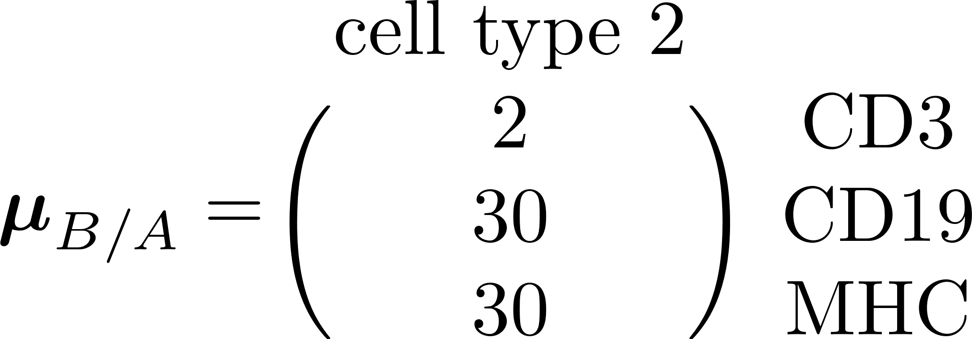
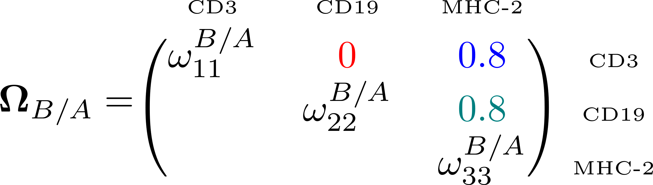
Step 2: Infer signature matrix ii) KDI exploration
One versus all
CD19
CD19
CD3
CD3
MHC-II
MHC-II
Sparse network in cell type A
Sparse network in cell type B
CD19
CD3
MHC-II
Differential network approach:
37
Introduction
Mixture models
Deconvolution
Perspectives

Slide 38
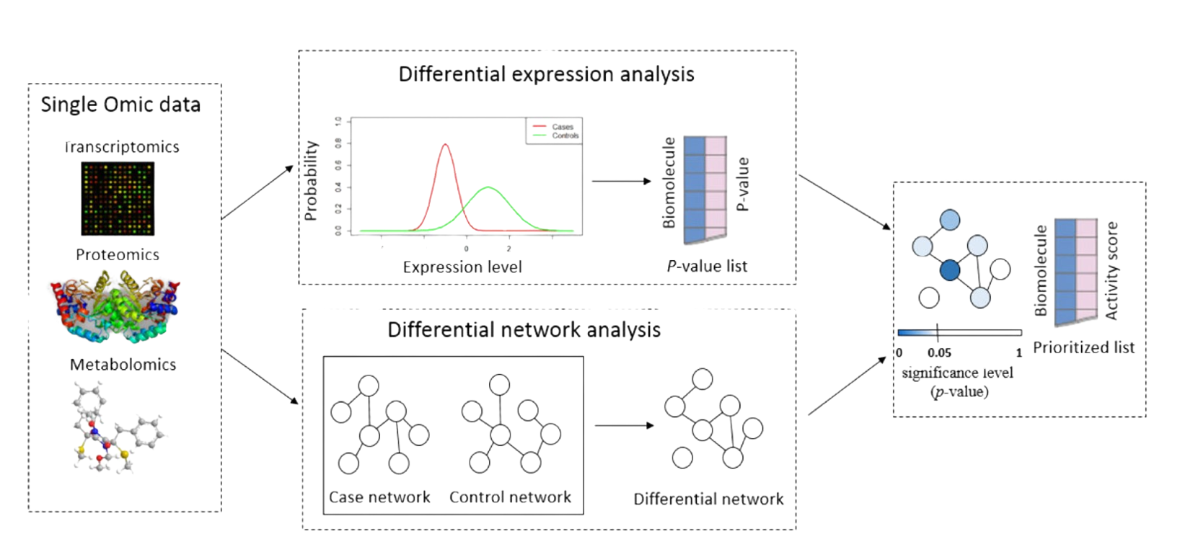
Step 2: Infer signature matrix ii) KDI exploration
One versus all
Objective of the INDEED algorithm: input is transcriptomic data and
the output is a ranked list gene based on their activity score.
INDEED pipeline
Estimate a sparse covariance structure using gLasso
Compute the resulting differential
Retrieve Neighbourhood: set of gene differentially connected
Sum activity scores S_i for each gene, return the ranked list in decreasing order
Zuo, 2016

Slide 39
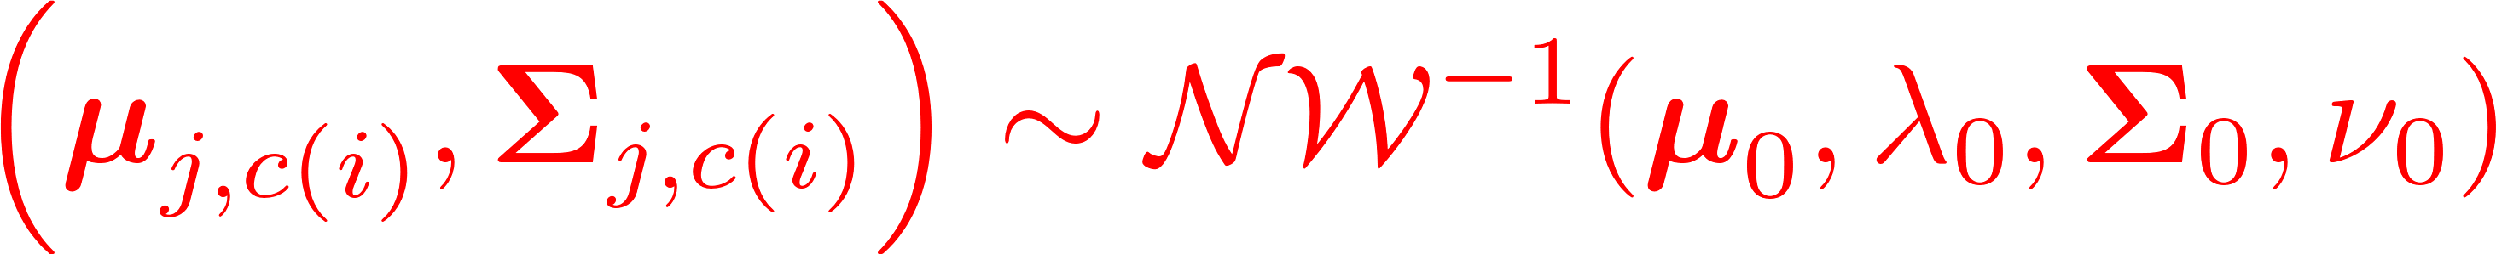
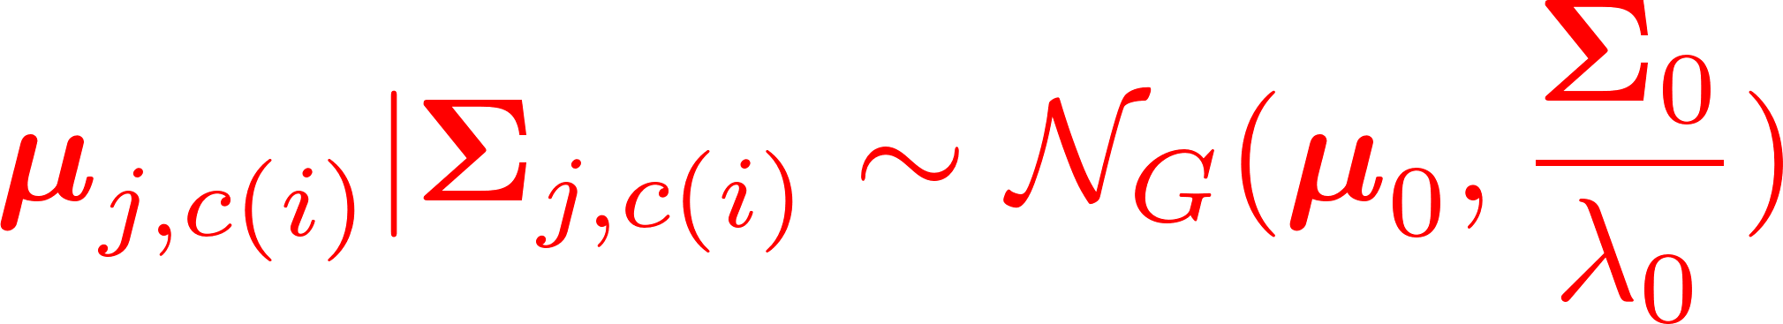

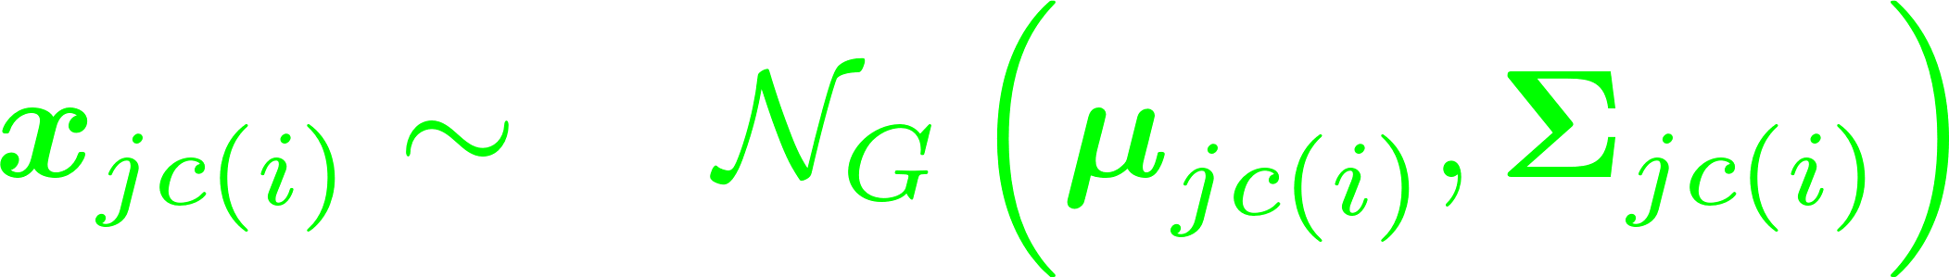








Differential network with a Bayesian framework
Step 2: Infer signature matrix ii) KDI exploration
One versus all
Originally implemented to deal with proteomic and partial datasets
Bayesian framework + conjugated distributions -> straightforward derivation of credible intervals
Multivariate framework address multiple test fallacy.
Outlooks: integrate priori knowledge weights derived from PPI databases
Graphical model of the Bayesian
generative model, in J cell types
http://arxiv.org/abs/2307.08975,
Chion et al, 2023, arXiv

Slide 40
Step 2: Infer signature matrix ii) KDI exploration
One versus all
CARNIVAL, and Cornetto Bioconductor package to switch from expression footprints to causal pathways
Relies on integer linear programming problem (ILP) -> constraint validation
https://www.nature.com/articles/s41540-019-0118-z
Rodriguez et al, 2019, Nature NPJ

Slide 41


Step 2: Infer signature matrix ii) KDI exploration
All versus all
Dual objective functions
handled with Pareto fronts
Hananeh Aliee, Cell, (2021)
Global objective function optimised
using a genetic algorithm
AutoGeneS: automated gene selection using multi-objective optimisation

Slide 42


Step 2: Infer signature matrix ii) KDI exploration
All versus all
Geometric interpretation
Probalistic interpretation
Probability of cluster 2 expression to be wrongly assigned to cluster 1
Total probability of wrong classification
Probability of cluster 1 to be wrongly assigned to cluster 2
Minimise global overlap as a global capstone function.

Slide 43

Step 2: Infer signature matrix Brainstorming time.
2) Differential
network analysis?
INDEED
DwgLasso
Should incorporate both differential expression and network rewirings.
1) Favorite network
inferences tools?
Graphical Lasso
Bayesian networks.
GENIE3
GRNBOOST
At the single-cell level, does it perform prior pseudo-bulk?
3) Global Feature
selection?
Minimise global overlap
Maximise Wasserstein distances
Pareto fronts to simultaneously optimize several metrics.

Slide 44
Outline of cellular deconvolution
1
01
Why Deconvolution?
2
02
Integrating Regulatory Pathways to Refine Cell-Type Characterization
3
DeCovarT: a network-centric approach to deconvolution
03
4
Towards the Third Generation
Of Deconvolution Algorithms
04
44
Introduction
Mixture models
Deconvolution
Perspectives

Slide 45
Overview of deconvolution pipeline
Step 3: DeCovarT
Step 1: collection and curation of datasets
Step 2: learn
cell-type
specific features
Step 4: biological exploitation
https://doi.org/10.1186/s13059-021-02290-6
Haijing, 2019, Genome Biology
45
Introduction
Mixture models
Deconvolution
Perspectives

Slide 46


Step 3: DeCovarT Brainstorming time.
Which tools to infer cellular composition? Which modelling categories?
1st generation of
deconvolution algorithms
CIBERSORT
QuantiSeq
DeCovarT
…
2nd generation of
deconvolution algorithms
MuSiC.
CIBERSORTx
Bisque
DWLS
…

Slide 47


Step 3: DeCovarT i) Partial deconvolution ecosystem review
Signature-based
Minimise quadratic error in a regression framework
or MLE/MAP of a probalistic model
Regression
Probalistic
Robust regression
CIBERSORT (Newman, 2015)
FARDEEP (Hao, 2019)
Quadratic programming
DeconRNASeq, Gong 2013
Discrete
distributions
PERT (Qiao, 2012)
TEMT (Li, 2013)
Continuous
distributions
Dsection
(Erkkilä, 2010)
Dmix(t) (Wang, 2018)
Uncoupling
MMAD
EPIC (Racle, 2017)
quanTIseq (Trajanoski, 2019)
Regularised
regression
DCQ (Altman, 2014)
ImmQuant (Frishberg, 2016)

Slide 48










Step 3: generative model of DeCoVarT
Nodes
Constant
parameter
Stochastic variable
Observations
lsfit, Abbas, 2009
Gaussian-Markov
OLS is the BLUE estimate
OLS = MLE estimate
Normal equations:
Parameters
Distributions
Likelihood Laws
48
Introduction
Mixture models
Deconvolution
Perspectives

Slide 49









Step 3: generative model of DeCoVarT
Nodes
Constant
parameter
Stochastic variable
Deterministic variable
Observations
Parameters
(1) Probability distribution of the sum of two independent random variables: X1+ X2 is equal to their convolution: X1 * X2
Prior parameters
Estimated parameters
Distribution probabilities
Prior laws
Likelihood Laws
Inspired from DemixT algorithm (Wang et al, 2018),
a univariate version of DeCovarT.
49
Introduction
Mixture models
Deconvolution
Perspectives

Slide 50







Log-likelihood associated to the model =
log-likelihood of a multivariate Gaussian distribution
Step 3: generative model of DeCoVarT
Challenge 1:
No explicit mapping
Compute the roots!
Newton Raphson method
Upgraded Marquardt-Levenberg,
in package marqLevAlg
Steepest descent method
BP Hejblum, (2021, R Journal)
50
Introduction
Mixture models
Deconvolution
Perspectives

Slide 51


Step 3: DeCovarT iv) DeCovarT numerical challenges
Log-likelihood associated to the model =
log-likelihood of a multivariate Gaussian distribution
Free tip: fully leverage the Matrix Cookbook!!
Explicit formula of the gradient, using matrix derivation algebra.
Explicit formula of the Hessian

Slide 52






Step 3: generative model of DeCoVarT
Challenge 2:
unit-simplex constraint
Chain-rule formula:
first order
C2 diffeomorphism
Support
Explicit form
Mapping function
52
Introduction
Mixture models
Deconvolution
Perspectives

Slide 53



Step 3: DeCovarT iv) DeCovarT numerical challenges
Challenge 3: Prove uniqueness of the solution
Prove global concavity of the log-likelihood function
Second derivative is negative everywhere.
Deal with multiple extrema using a simulated annealing approach
Miroslaw Blocho,
Smart Delivery Systems, 2020

Slide 54



Step 3: DeCovarT iv) DeCovarT numerical challenges
Challenge 4: Identifiability and joint optimisation
DAG DeCovarT
Heuristic plug-in instead of unobserved.
Struggles with identifiability issues.
MCMC pseudocode

Slide 55




Step 3: DeCovarT iv) DeCovarT numerical challenges
Challenge 5: Evaluate uncertainty on the estimation of cellular composition
Derivation of confidence intervals
Bootstrap
Fisher information
matrix(FMI)
MLE estimate is asymptotically efficient -> empirical variance approaches the
Cramér-Rao lower bound
Exact formula of the expected FIM when the parameter of interest follows a multivariate GMM

Slide 56


Step 3: DeCovarT iv) DeCovarT numerical challenges
Challenge 6:
Assumption of Normal distribution ->
Log-transform transcriptomic inputs ->
Fundamental linearity assumption discarded
Solution? -> Poisson-log Normal distribution
Model observed counts data with Poisson distribution
Capture pairwise interactions with a MVN distribution.
Graphical abstract of PLNmodels
https://www.frontiersin.org/journals/ecology-and-evolution/articles/10.3389/fevo.2021.588292/full, Chiquet et al, 2023, Frontiers

Slide 57

Step 3: DeCovarT iv) DeCovarT numerical challenges
Challenge 5:
Assumption of Normal distribution ->
Log-transform transcriptomic inputs ->
Fundamental linearity assumption discarded
Solution? -> Existing RCTD
(Robust Cell Type Decomposition)
Model observed counts data with Poisson univariate!!
Includes technical noise, as a gene-specific capture efficiency.
https://www.nature.com/articles/s41587-021-00830-w , Cable et al, 2021, Nature Biotechnology

Slide 58







Toy example
Cell profiles generation
Proportion settings
Scenario 1:
Bulk mixture reconstruction
Generation of N=2000 bulk samples y
58
Introduction
Mixture models
Deconvolution
Perspectives
Simulation framework

Slide 59











WHO is WHO?
Match simulations scenarios
with their parameters’ configurations

Slide 60
WHO is WHO?
Match simulations scenarios
with their parameters’ configurations
Toy example

Slide 61
WHO is WHO?
Match simulations scenarios
with their parameters’ configurations
Toy example

Slide 62
WHO is WHO?
Match simulations scenarios
with their parameters’ configurations
Toy example

Slide 63






Step 3: DeCovarT v) Toy example
DeconRNASeq (to the left)
VS DeCovarT (on the right)

Slide 64
Zoom on Deconvolution Algorithms
1
01
Introduction and Key Challenges in Deconvolution
2
02
Integrating Regulatory Pathways to Refine Cell-Type Characterization
3
DeCovarT: a network-centric approach to deconvolution
03
4
Towards the Third Generation
Of Deconvolution Algorithms
04

Slide 65
DeCovarT major Contributions
and Avenues
Challenging Cell types
Rare cell types (mastR)
Spillover
Evaluation of unknown (tumoral) content
Robust generative model
p-values and statistical tests for compositional data and population levels
Distributions closer to intrinsic
discrete nature of transcriptomic
Environmental variation
Integration of tropic conditions
(tissue, method, disease, …)
Spatio-(temporal) resolution
Hierarchical structure: trade-off between coarse or fine-grained representation.
Standardised workflow
Disease, tissue and cell type ontologies
GRN structure
Co-expressed genes captured
in the generative model: pathways

Slide 66






General conclusion and outlooks
01
03
Deconvolution pros
Less intrusive compared to FACS
Automated identification of biomarkers
Transcriptomic depth and coverage,
Cheaper than scRNA-Seq
02
Innovative solutions
Benchmark methods and combine signatures( omnideconv)
Network structure (DeCovarT), multi-omics integration (GEM-DeCan, Barbot)
Multi-signature characterisation (CellFusion)
Unravel new malignant cell states biomarkers (CDState, mastR)
Deconvolution limitations
Inconsistent outcomes
Spillover (closely related cell types)
Tropic dependant
Unknown tumoral content

Slide 67








The omnideconv project and ecosystem
Standardise performance metrics and signature matrices
https://omnideconv.org/
Collaboration with Markus List (TUM)

Slide 68


European consortium
Towards the 3rd generation of deconvolution algorithms
Tutorials and
workshops
HaDaCa Data challenge
Online Internship
Scientific animations (GDR BIMMM, Elixir Hackathon, …).
Consortium publication
Best deconvolution guidelines, for specific tasks or generalization to other species. Unified and open-source framework (omnideconv).
Colloquium with pathologists and cytologists to standardize annotation of cell populations
SYMPOSIUM
EXCHANGES
WORKSHOPS
CONFERENCES
PUBLICATIONS
3rd DECONVOLUTION
NGS?
Academic exchanges
GDR BIMMM(only between French)
DAAD, Procope (German scholarships)
COFUND MSCA
EMBO Exchange Grant
Conferences
Deconvolution at the era of single-cell RNASeq and spatial omics

Slide 69
The Poisson-Lognormal Model for the Joint Analysis of discrete Abundances
Standard method: transform the counts to pseudo-Gaussian observations using simple transforms before moving back to the setting of Gaussian Graphical Models with known methods for analyzing them
Joint Species Distribution Models (JSDM) to study joint abundances:
Account for both structuring factors (environmental characteristics -> tissue characteristics) and potential interactions between the species -> the transcripts
Gaussian latent layer to encode the dependencies between entities (with a covariance matrix)
multivariate Poisson-lognormal (PLN) is a versatile framework, to perform multivariate sample comparison, clustering of samples, or inferring interaction networks.
All models are implemented in the R package PLNmodels
Additional resources:
Variational Inference for sparse network reconstruction from count data
Inferring multiple graphical structures , fusing graphs strategies implemented in the simone package-> could be reemployed to aggregate networks proceeding from distinct sources/ sequencing technologies, or even maybe distinct biological conditions (mitigate technical bias, while enhancing biological discrepancy?, in a sparse context)
Graphical Lasso: https://bochang.me/gmrg/files/Bo_05152015.pdf
Julien Chiquet, Mahendra Mariadassou and Stéphane Robin

Slide 70

Upgraded Levenberg Marquardt algorithm
If all the eigenvalues of the Hessian at a given point are negative, the matrix is negative-definite.
strictly “concave” function -> guarantees uniqueness of a global maximum.
Improved LMA keeps the middle ground between the steepest descent method and the Newton method:
o Better delineate saddle points from true extremums
o Hyper-parameters controlling the inflation of the reparametrized Hessian matrix are automatically updated to ensure that:
(i) the Hessian is negative-definite at each iteration
(ii) the reparametrized Hessian converges to the true Hessian close to the extremum -> If reduction is too fast, a smaller value can be used, bringing the algorithm closer to steepest descent. On the other hand, slow convergence can be boosted by giving more weight to the Hessian denominator.
(iii) Relative distance to minimum/maximum (RDM) is a more stringent convergence criteria, interpretable as the ratio between numerical and statistical approximation.

Slide 71


Upgraded Levenberg Marquardt algorithm
How to fix good thresholds? (at least for parameters stability which depend on the order of magnitude).
First two stopping rules are not linked to the properties of the surface to maximize -> slower iterations may just illustrate that the algorithm got stuck and be unable to find a good direction
Third Criteria is asymptotically invariant near the maximum to any one-to-one transformation
Resources:
https://arxiv.org/abs/math/0610402
https://www.sciencedirect.com/science/article/abs/pii/S0169260713001363
https://en.wikipedia.org/wiki/Chi-squared_distribution

Slide 72

Additional simulation results
Existing standard deconvolution algorithms

Slide 73

Additional simulation results
Same variants of the DeCovarT framework

Slide 74


Additional simulation results
Description of the hyper-parameters used in some of the optimisation functions

